Slide 1

GP CPCS
General Practice referral pathway to the NHS
Community Pharmacy Consultation Service
GP Staff Training

Slide 2
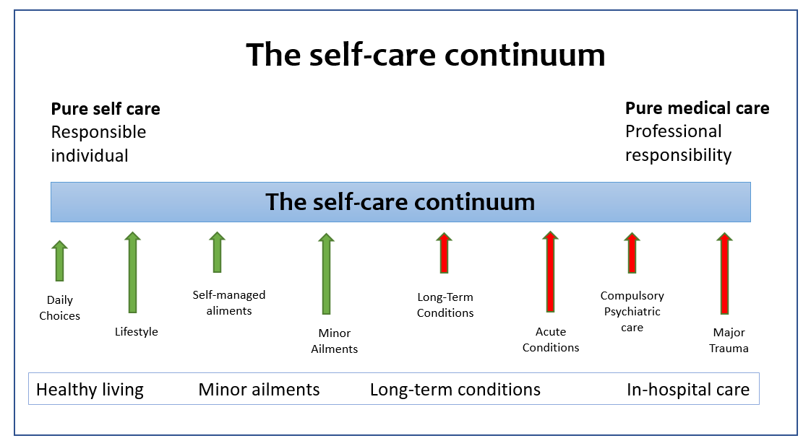
Common Ailments and Self-care

Slide 3
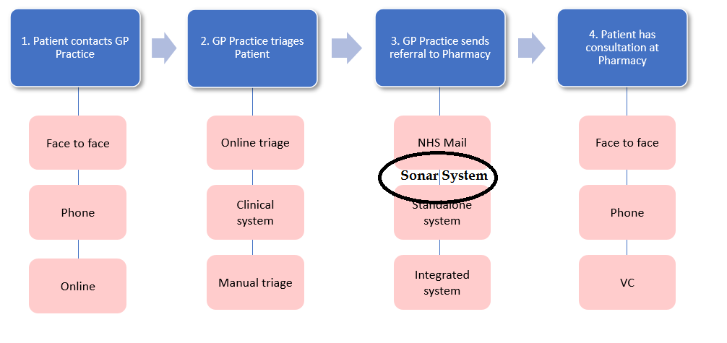
GPCPCS Patient Journey

Slide 4
What is GP CPCS?
General Practice referral pathway to the NHS Community Pharmacy Consultation Service
Safe Monitored pathway
2019 via NHS 111 & 111-online
GP CPCS –Is now a National NHS Service
Refer Minor illness to Pharmacy
(Common Ailments )
A Structured Consultation- record made and shared with GP
AIM – To resolve patient issue & improve self care
Escalation If and when required
Patient feedback – can refine & improve service
Detailed Reports for GPs on Sonar Platform
More GP appointment time for patients with complex needs
Integrate Pharmacy as part of your team
( GP – Pharmacy working closer for better outcomes)
Notes:
The CPCS – Or Community Pharmacy Consultation service has been operational now for 2 + years - with the results so far estimates are of the 60 million ( 11 weeks of GP time per annum) consultation in GP surgeries for Minor illness 20 M could be safely transferred – equated to approx. 3- 10 consultation per day
GP CPCPS is NOW a national service with clear Pharmacy side experience and a structured consultation and record keeping. If exceptions are required it follows a set pathway.
Main focus and reason to set up the GPCPCS is to help resolve the patient Situation /condition as soon as possible and help improve the patient self management skills for self care, and use primary care ressources better .

Slide 5
GP and Pharmacy PCN - GPCPCS set up process
PCN stakeholders determine how to implement the referral pathway, strong relationships between Pharmacy and GP practice colleagues.
Prep work required and exchange of formal launch dates and a PCN wide approach.
Clinical Governance -Community Pharmacy PCN lead , PCN clinical lead to exchange and agree a process.
Set up Start date 1-2 weeks. Training for all GP staff on conditions / use of Sonar platform.
Check list

Slide 6
Checklist to start process
Referral method operational: reception staff have the appropriate training and feel competent to make referrals.
Process for monitoring arrangements for referrals and gathering staff/patient feedback including handling of any incidents.
Patient communication made available advising about referral pathway (practice digital screens, answer phone, website, social media etc.
Post-event message (PEM) process (from pharmacy to practice). Practice staff aware of process to manage PEMs received from community pharmacy.
Contact details shared with agreed process for notifying the practice of “ Urgent Referral Back to GP” +Any changes to Service .Healthcare professional telephones, and email addresses, shared with both the practice and pharmacy- GP Bypass Phone Number.
Agree a ‘go-live’ date when the practice will be ready to make referrals and communicate this to regional implementation lead(s).Sonar to offer training to all GP staff - Access to Sonar and Introduction to Conditions for GPCPCS Referral .

Slide 7
Words Matter
Terms and wording - Important - words can be interpreted differently!
“We are referring you for a personal consultation to a NHS service”
“I am sending you for a same day appointment with an NHS community pharmacist for a personal consultation”
“Once the pharmacist has received the referral, they will contact you by phone in a timely manner”
This is NOT a Sign posting service - Formal Electronic referral (similar to a X -ray , Blood tests etc. Patient will be seen, and a record made which can be shared back to the GP if required)
Suggested script for reception teams/care navigators to use on initial phone calls with patients (Word Doc - in system )

Slide 8
GP CPCS – Medical Conditions allowed for referral
50+ Medical Conditions
Acne, Spots and Pimples
Arm, Pain or Swelling
Blisters
Cough
Earache
Eye, Sticky or Watery
Failed Contraception
Headache
Itch
Lower Back Pain
Nasal Congestion
Scabies
Sleep Difficulties
Tiredness (Fatigue)
Wound Problems
Allergic Reaction
Athlete's Foot
Cold or Flu
Diarrhea
Eye, Painful
Eye, Visual Loss or Disturbance
Hair loss
Hearing Problems or Blocked Ear
Knee or Lower Leg Pain or Swelling
Lower Limb Pain or Swelling
Pain and/or Frequency Passing Urine
Shoulder Pain
Sore Throat and Hoarse Voice
Toe Pain or Swelling
Wrist, Hand or Finger Pain or Swelling
Ankle or Foot Pain or Swelling
Bites or Stings , Insect or spider
Constipation
Ear Discharge or Ear Wax
Eye, Red or Irritable
Eyelid Problems
Head Lice
Hip, Thigh or Buttock Pain or Swelling
Limb, cold or color change
Mouth Ulcers
Rectal Pain, Swelling, Lump or Itch
Skin, Rash
Tattoos, Birthmarks or Moles
Vomiting

Slide 9
GP CPCS – Medical Conditions
Basic Introduction for Non-Clinical Staff

Slide 10
Bites/Stings
Suitable for referral to pharmacists ?
Bee Sting
Wasp Sting
Stings with minor redness
Stings with minor swelling
Do NOT refer in these circumstances
Drowsy/fever
Fast heart rate
Severe swelling or cramps
Pharmacist will inform patient to revisit Pharmacy and arrange a follow-up if symptoms are worsening or persisting.

Slide 11
Colds
Suitable for referral to pharmacists ?
Cold sores
Coughs
Flu-like symptoms
Sore throat
Do NOT refer in these circumstances
Lasted + 3 weeks
Shortness of breath
Chest pain
Unable to swallow
Pharmacist will inform patient to revisit Pharmacy and arrange a follow-up if symptoms are worsening or persisting.

Slide 12
Congestion
Suitable for referral to pharmacists ?
Blocked or runny nose
Constant need to clear their throat
Excess mucus
Hay fever
Do NOT refer in these circumstances
Lasted +3 weeks
Shortness of breath
One side obstruction
Facial swelling
Pharmacist will inform patient to revisit Pharmacy and arrange a follow-up if symptoms are worsening or persisting.

Slide 13
Ear
Suitable for referral to pharmacists ?
Earache
Ear wax
blocked ear
Hearing problems
Do NOT refer in these circumstances
Something may be in the ear canal
Discharge
Severe Pain
Deafness, Vertigo
Pharmacist will inform patient to revisit Pharmacy and arrange a follow-up if symptoms are worsening or persisting.

Slide 14
Eye
Suitable for referral to pharmacists ?
Conjunctivitis Link
Dry/Sore tired eyes Dry /Sore eyes
Eye red or irritable
Eye sticky
Eyelid problems
Watery/runny eyes
Do NOT refer in these circumstances
Severe pain
Pain 1 side only
Light sensitivity
Reduced vision
Pharmacist will inform patient to revisit Pharmacy and arrange a follow-up if symptoms are worsening or persisting.

Slide 15
Gastric/Bowl
Suitable for referral to pharmacists ?
Constipation
Diarrhea
Infant colic
Heartburn
Indigestion
Hemorrhoids
Rectal pain
Vomiting or nausea
Do NOT refer in these circumstances
Severe/ongoing
Lasted +6 weeks
Patient +55 years
Blood/weight loss
Pharmacist will inform patient to revisit Pharmacy and arrange a follow-up if symptoms are worsening or persisting.

Slide 16
General
Suitable for referral to pharmacists ?
Hay Fever
Sleep difficulties
Tiredness
Do NOT refer in these circumstances
Severe/ongoing
Pharmacist will inform patient to revisit Pharmacy and arrange a follow-up if symptoms are worsening or persisting.

Slide 17
Gynae/Thrush
Suitable for referral to pharmacists ?
Cystitis
Vaginal discharge
Vaginal itch or soreness
Do NOT refer in these circumstances
Diabetic/Pregnant
Under 16/Over 60
Unexplained bleeding
Pharmacy treatment not worked
Had thrush 2 times in last 6 months
Pharmacist will inform patient to revisit Pharmacy and arrange a follow-up if symptoms are worsening or persisting.

Slide 18
Pain
Suitable for referral to pharmacists ?
Acute pain
Ankle or foot pain
Headache
Hip pain or swelling
Knee or leg pain
Lower back pain
Lower limb pain
Migraine
Shoulder pain
Sprains and strains
Thigh or buttock pain
Wrist, hand or finger pain
Do NOT refer in these circumstances
Condition described as severe/urgent
Conditions have been ongoing for +3 weeks
Chest pain radiating into the shoulder
Pharmacy treatment not worked
Sudden onset
Pharmacist will inform patient to revisit Pharmacy and arrange a follow-up if symptoms are worsening or persisting.

Slide 19
Skin
Suitable for referral to pharmacists ?
Acne spots and pimples
Athletes foot
Blisters on foot
Dermatitis/dry skin
Hair loss, Hay fever
Nappy rash
Oral thrush
Rash – allergy
Ringworm/threadworm
Scabies
Skin dressings
Skin rash
Warts
Wound Problem
Do NOT refer in these circumstances
Condition described as severe/urgent
Condition has been ongoing for +3 weeks
Pharmacy treatment not working
Skin lesions/blisters with discharge
Diabetes related
Pharmacist will inform patient to revisit Pharmacy and arrange a follow-up if symptoms are worsening or persisting.

Slide 20
Mouth/Throat
Suitable for referral to pharmacists ?
Cold sore blisters
Flu-like symptoms
Hoarseness
Mouth ulcers
Sore mouth
Sore throat
Oral thrush
Teething
Toothache
Do NOT refer in these circumstances
Lasted +10 days
Swollen painful gums
Sores inside mouth
Unable to swallow
Patient has poor immune system
Voice change
Pharmacist will inform patient to revisit Pharmacy and arrange a follow-up if symptoms are worsening or persisting.

Slide 21
GP CPCS - Overview
Community Pharmacy Consultation service
GP Staff Training
GP Panel
Pharmacy Panel
Complete structured consultation.
Where appropriate Patient notification will be sent to the GP via ITK or @nhs.net email
Training materials online Charts & webinars Medical conditions
IT system training
GP Team sends a referral to the pharmacy
Listed Common Ailments
Patient Feedback Via text or emails
Feedback form will be sent to the patient once the GP CPCS consultation has been completed

Slide 22
GP CPCS – Training
Training to be provided to all reception staff and others via webinar (Recorded webinar available to be viewed anytime) to understand conditions and the use of the Sonar GPCPCS materials and the IT system.
No additional Costs to GP or PCN for GPCPCS ( Integration funding may be applied for with PCN support).
Easy to use flip charts to be available on reception counter, with medical conditions which can and cannot be referred to the pharmacies.
Condition | Can Refer to Pharmacy | Can not Refer to Pharmacy
Condition A | Symptom 1, Symptom 2 | Symptom 3, Symptom 4

Slide 23
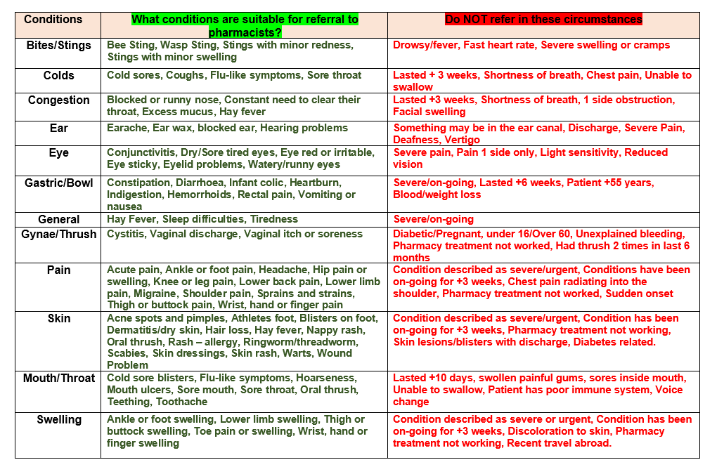
GP CPCS – Conditions to Refer Pharmacy

Slide 24
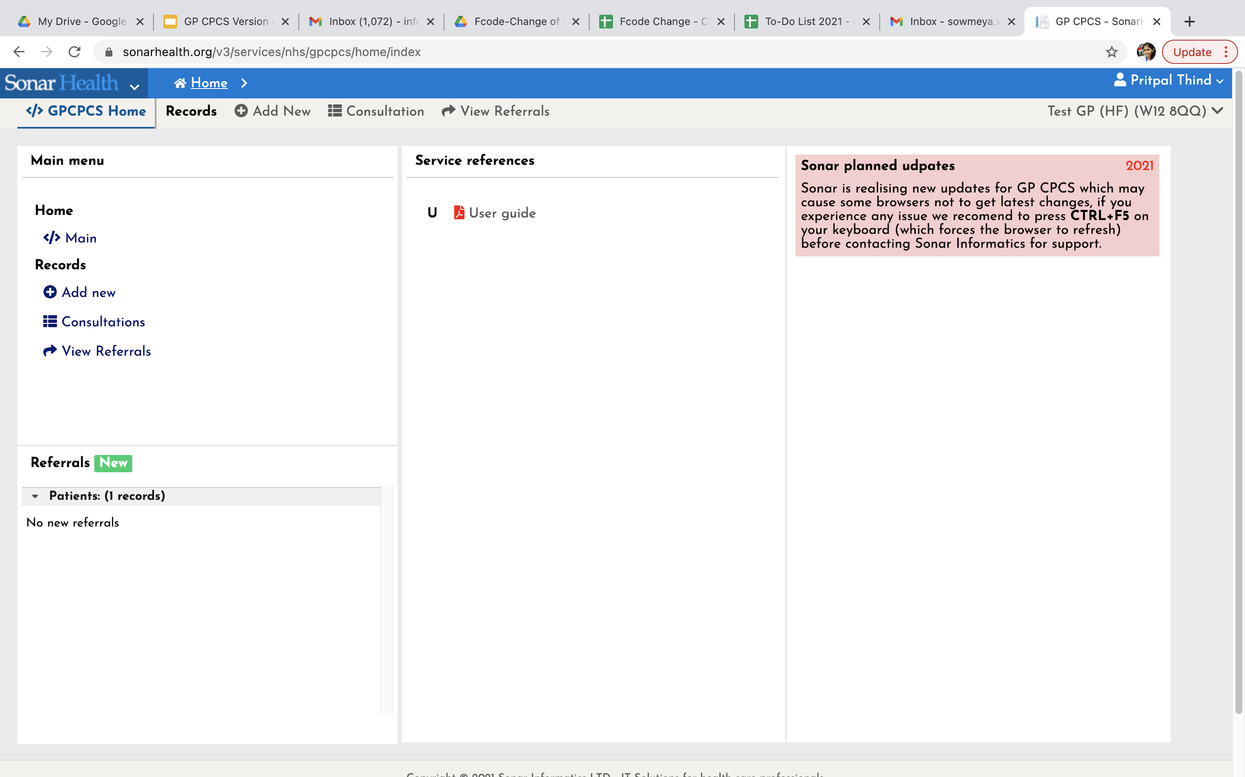
Login to go to GP CPCS – Home Page
Add New” to enter the patient details.

Slide 25
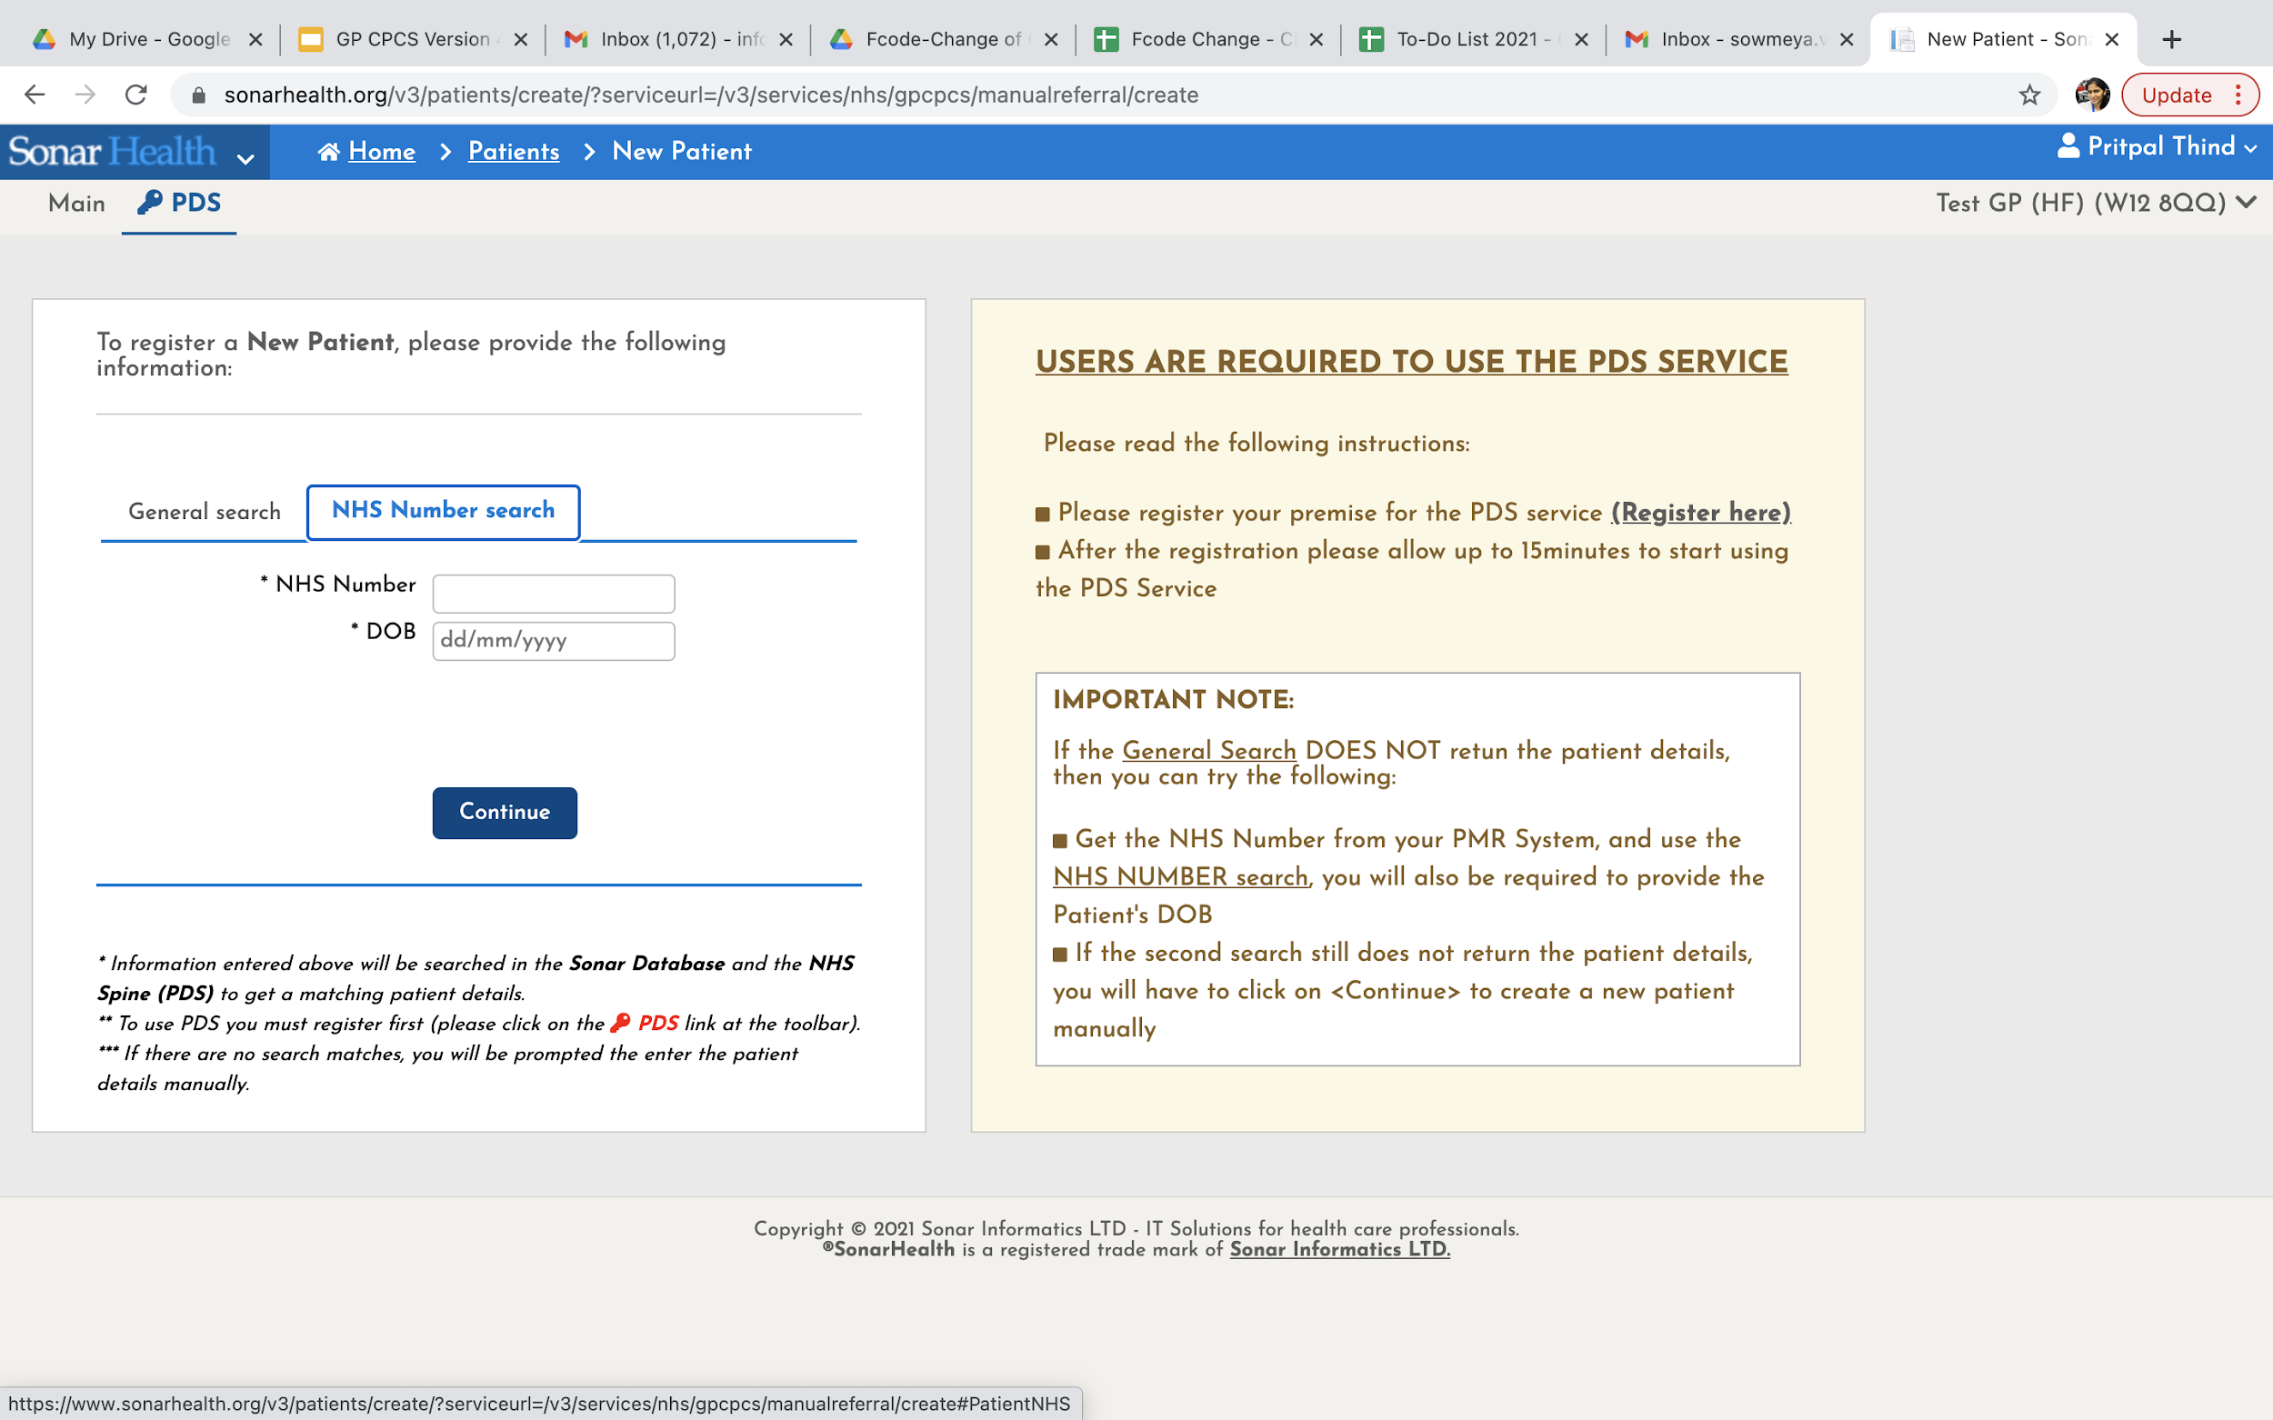
GP CPCS – Add a new Patient
NHS number and DOB
Or
“General Search” First name, Surname, DOB and Gender

Slide 26
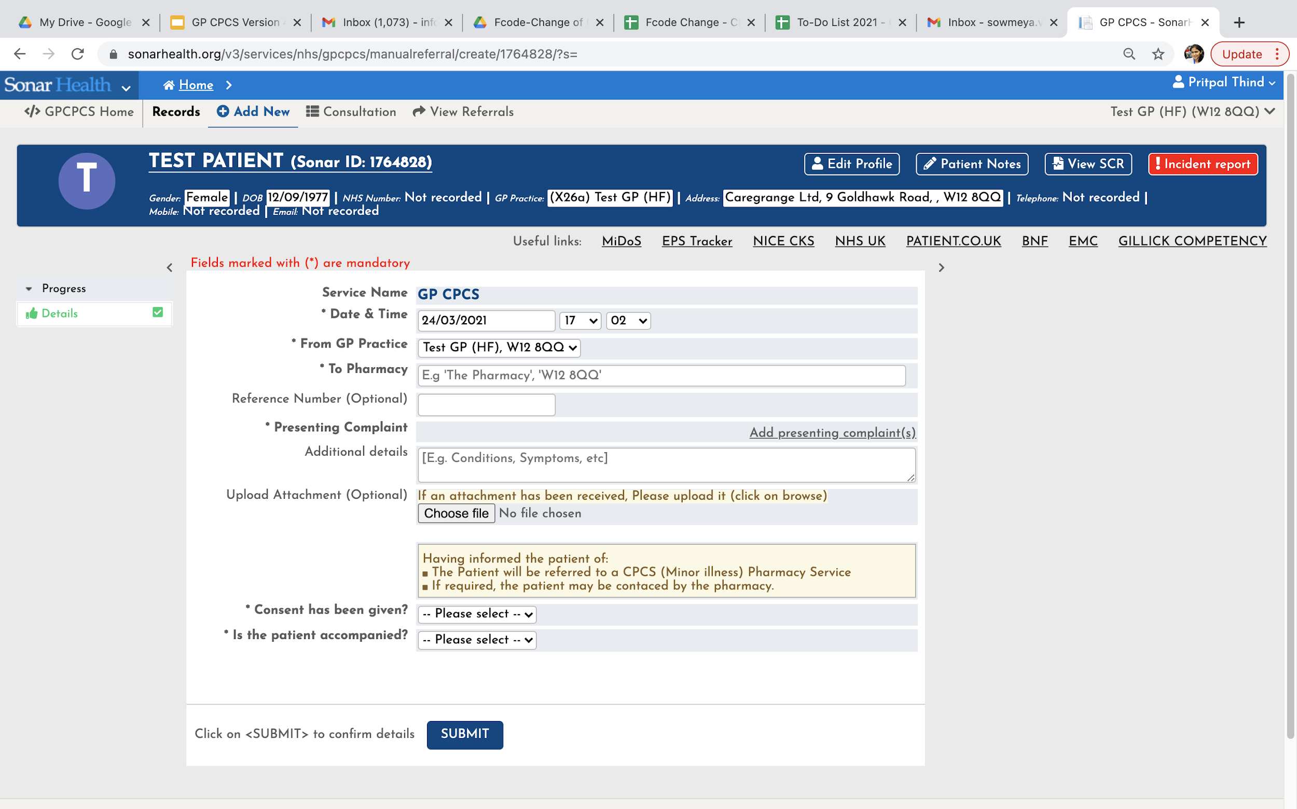
GP CPCS – Enter Patient Details
1. Choose Pharmacy ( Patient Choice only)
2. Select presenting complaint(s)
3. Patient Consent

Slide 27
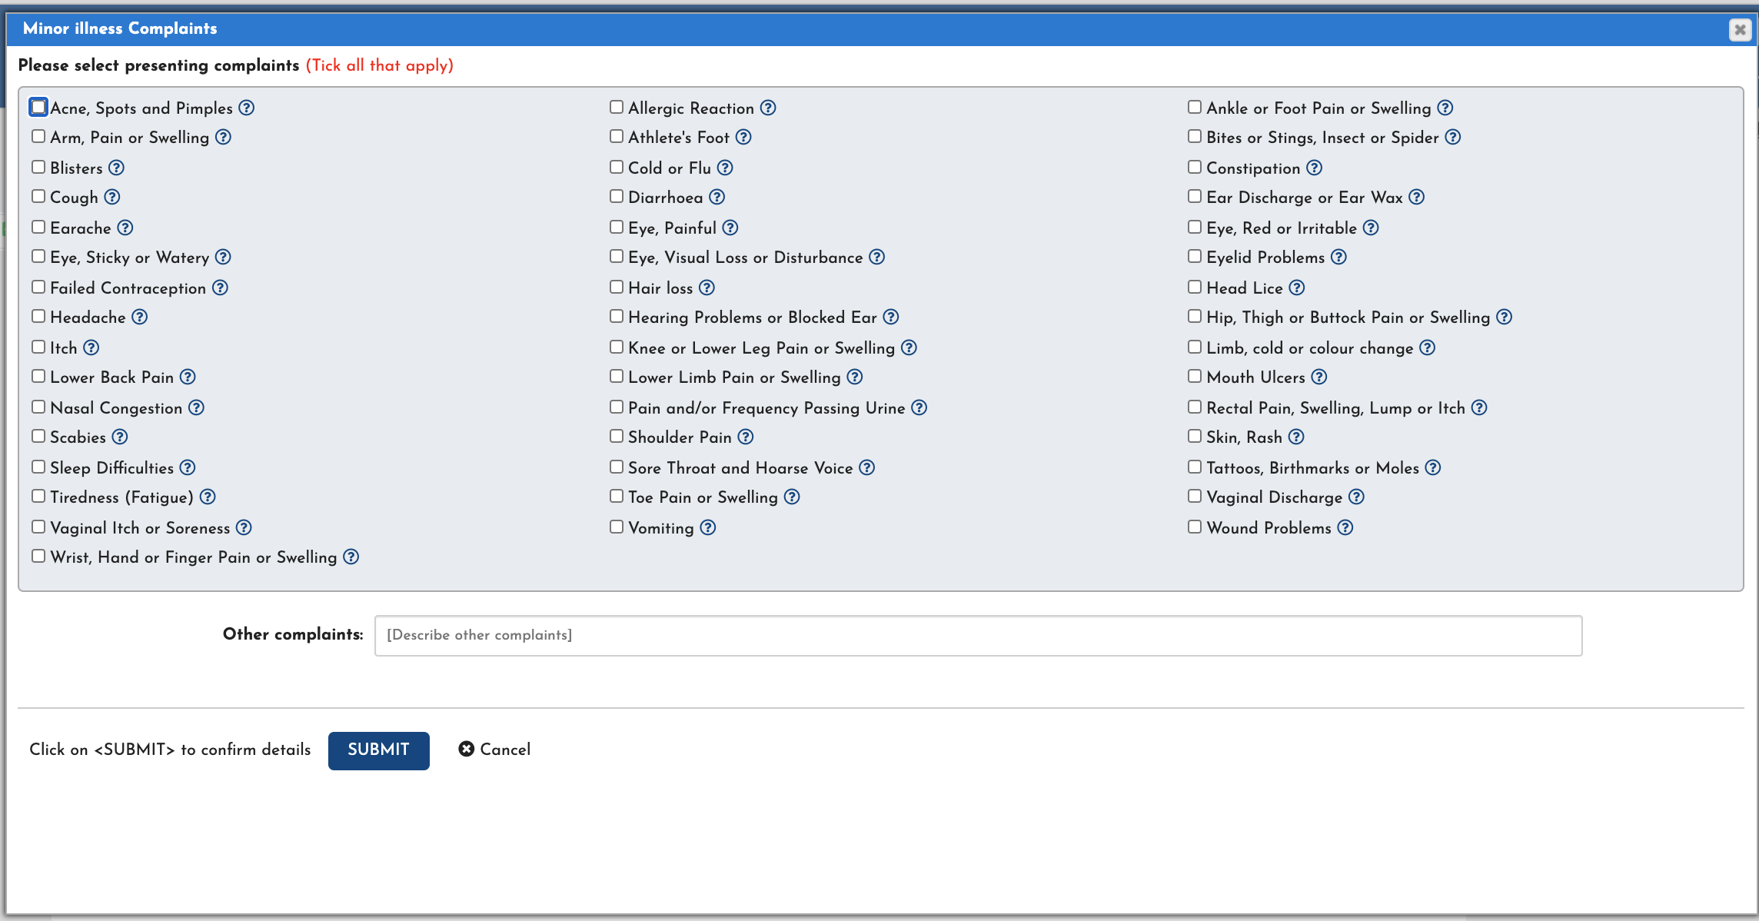
GP CPCS – Select Medical Conditions

Slide 28
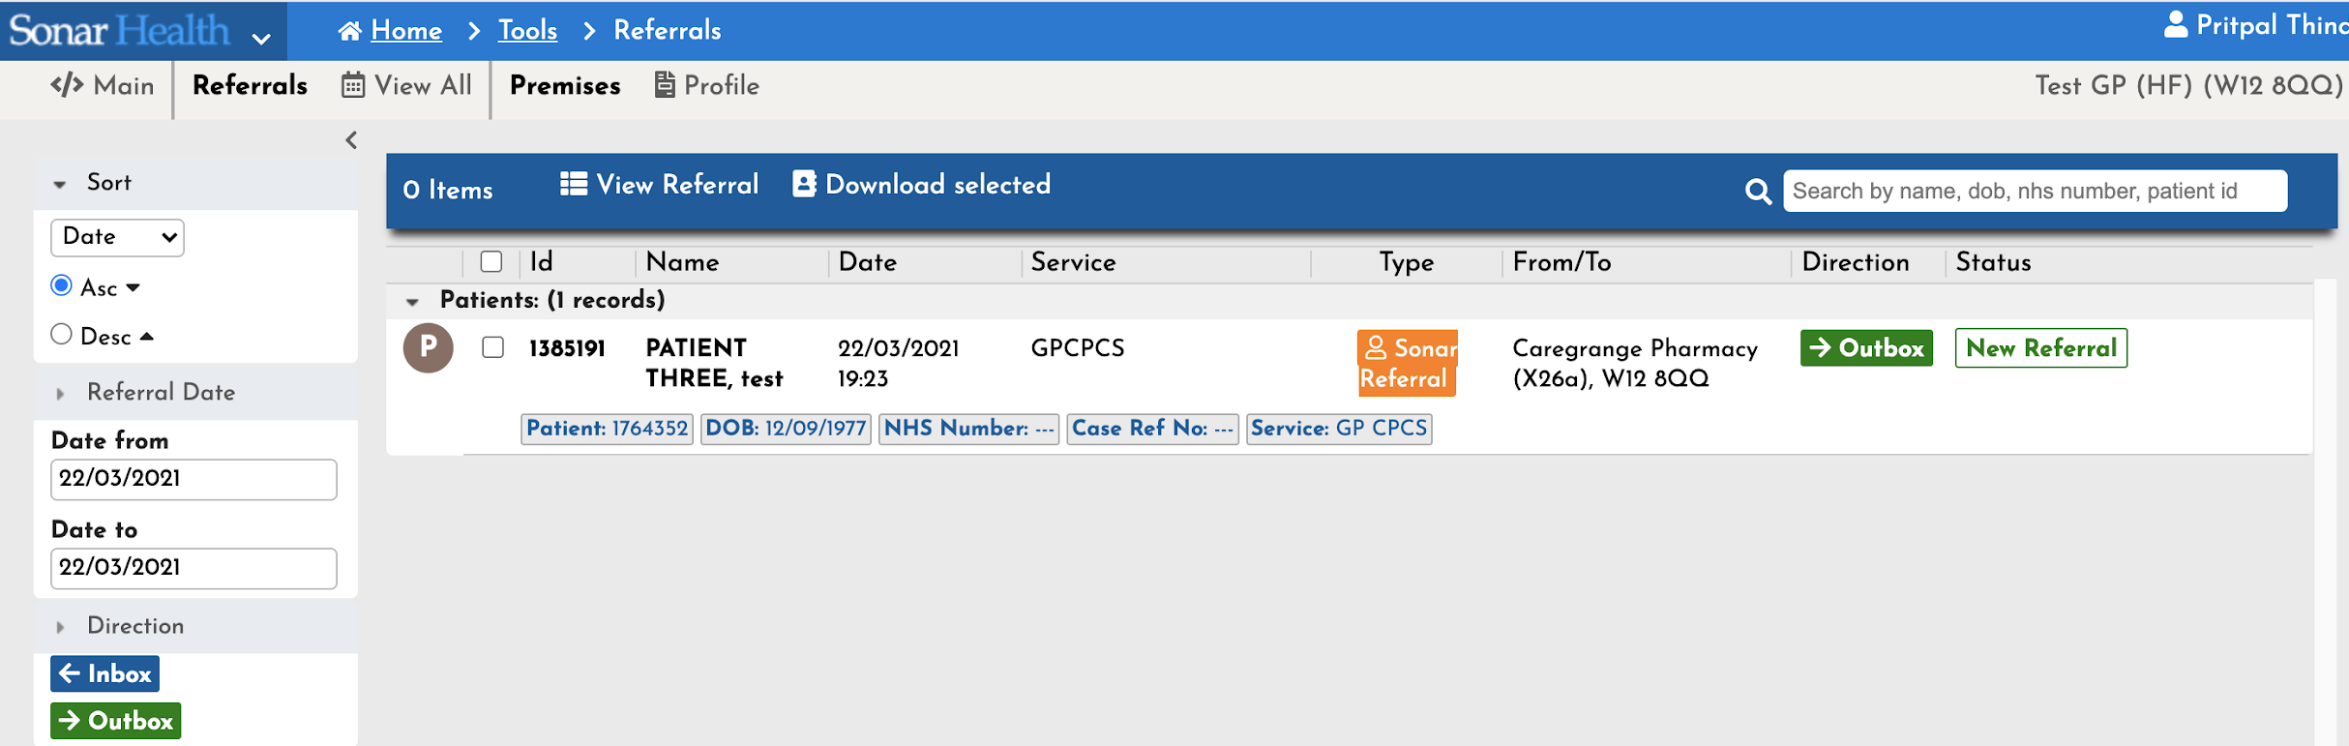
GP CPCS – New Referral created
Record status will change As Patient goes through Process

Slide 29
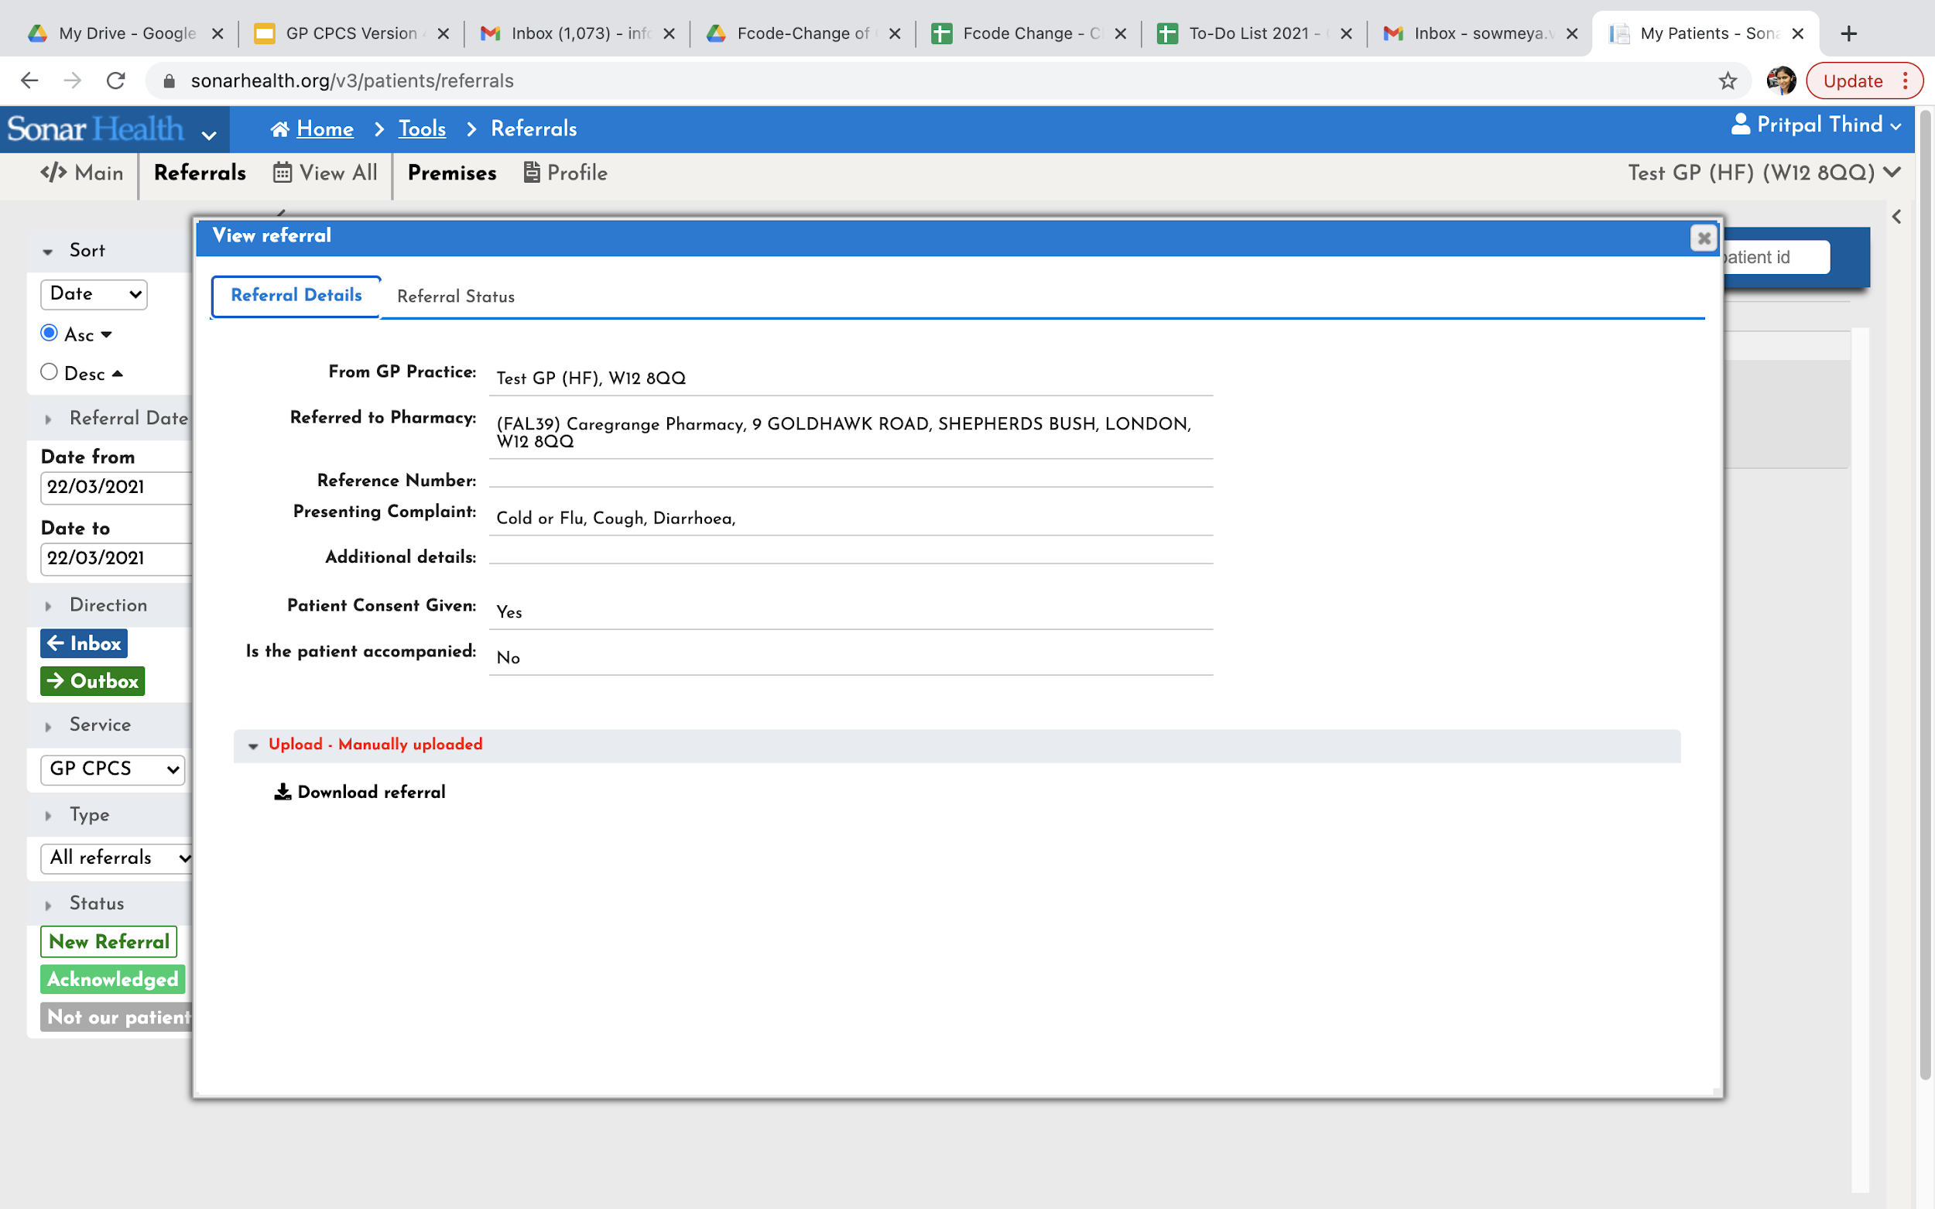
GP CPCS – View Referral
To view the patient record once created, select the patient record and click “View Referral”.

Slide 30
In summary
“I am sending you for a same day appointment with an NHS community pharmacist for a personal consultation”
GP sends a CPCS referral –
Pharmacy completes a structured consultation on Sonar system - feedback to GP where required
The Pharmacy
Pharmacist to review patient symptoms for referral, history, existing condition, current medication , onset and duration , other factors
View SCR – summary care record ( current and discontinued medication, Current Confirmed allergies, plus optional others information -Vaccinations etc.)
Review NICE – CKS clinical knowledge summaries -Review Red Flags
90% of patient - episode is resolved and closed.
Sonar System
PDS - Confirm patient ID using PDS ( Patient demographics service - Picks up Tel No , email)
ITK -All records sent to GP system via @nhs.net
Direct Access -to Sonar as for flu. Log-in and retrieve reports and records anytime

Slide 31
Thank You
Pritpal.thind@sonarinformatics.com
9 Goldhawk Road
London W12 8QQ
0208 811 2307
07783937021

